Slide 1
Experienced-Based Belief Learning for Structured Animation Code Generation
Joshua Then
Supervisors: Daochang Liu, Wei Liu

Slide 2
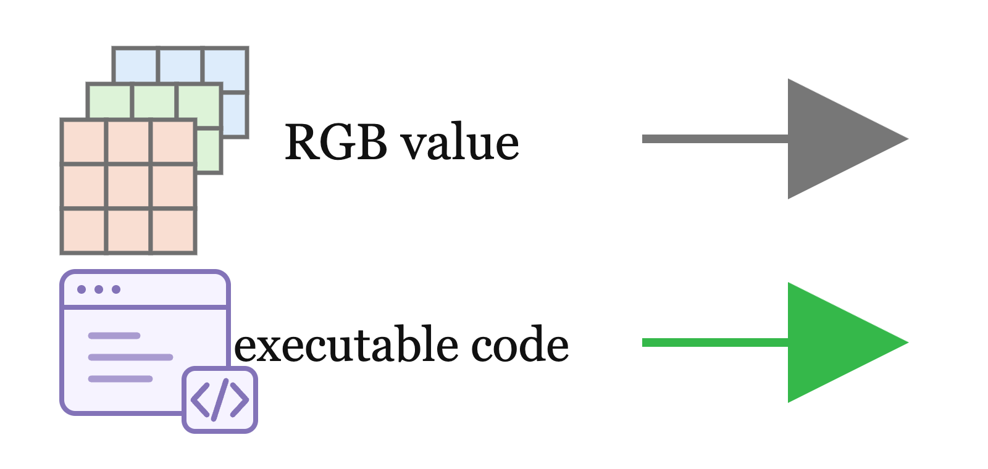
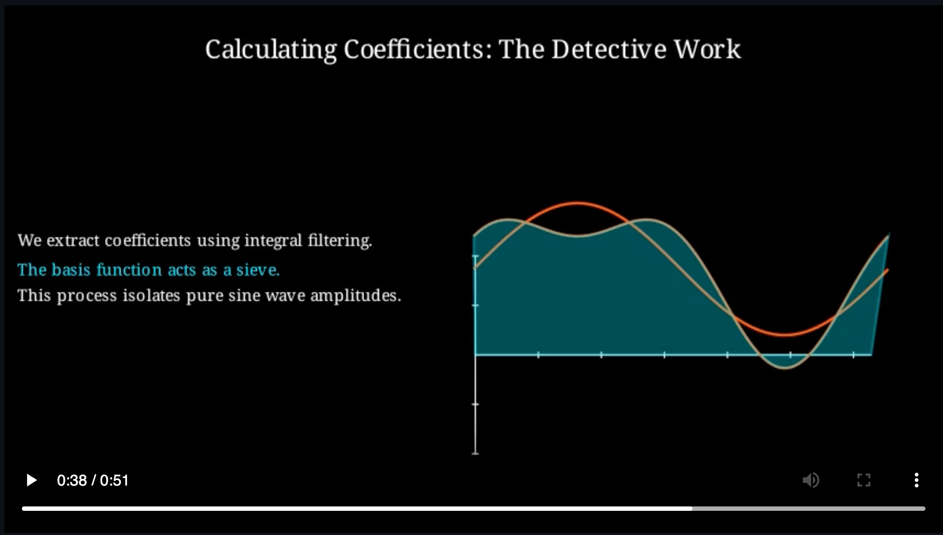
Structured Animation Code
Pixel-Based Video (Ho et al., 2022) | Structured Animation Code (Chen et al., 2025)
Direct frame synthesis No object-level representation Outputs vary across generations | Generates executable code Objects and timing are editable Deterministic rendering
RGB Values in Frames
Video
Structured Animation Code

Slide 3
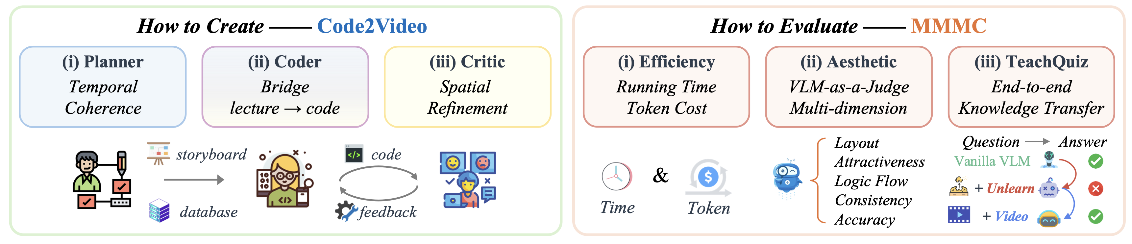
Code2Video
Generates educational mathematics videos as structured animation code
Evaluates efficiency, aesthetics and educational quality
Reproduced from Chen et al. (2025).

Slide 4
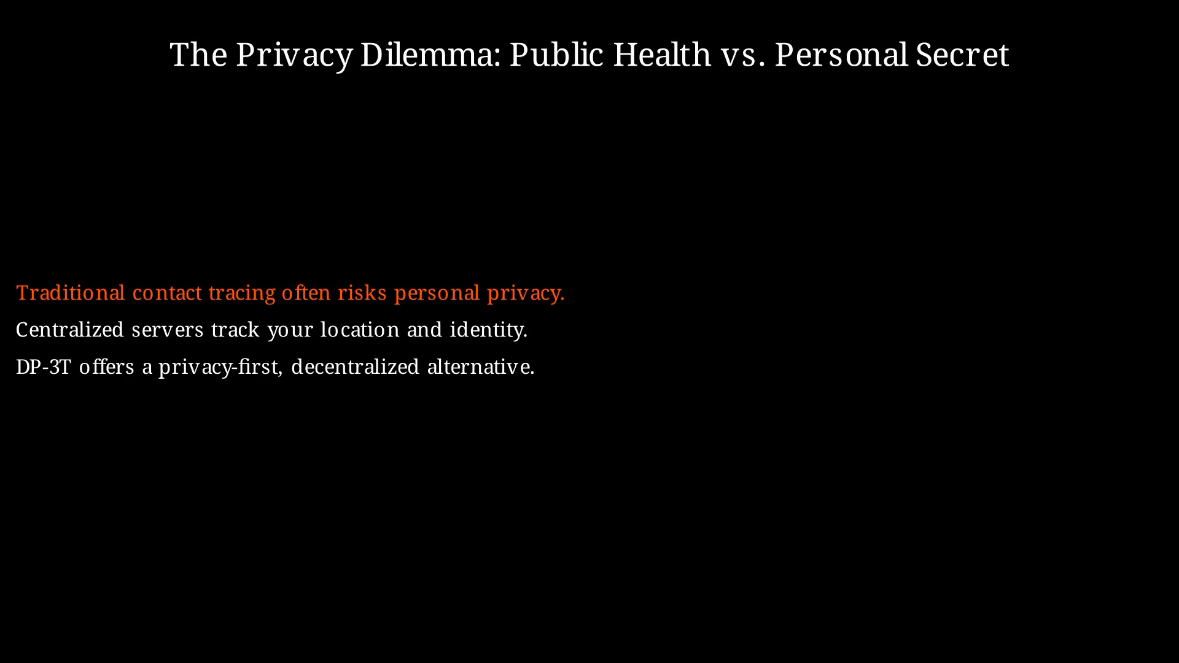

Slide 5
Forgotten Experience
Runs can come across similar failures and errors
No retention at the end of a run
“Can execution experience be converted into reusable beliefs that guide subsequent runs?”

Slide 6
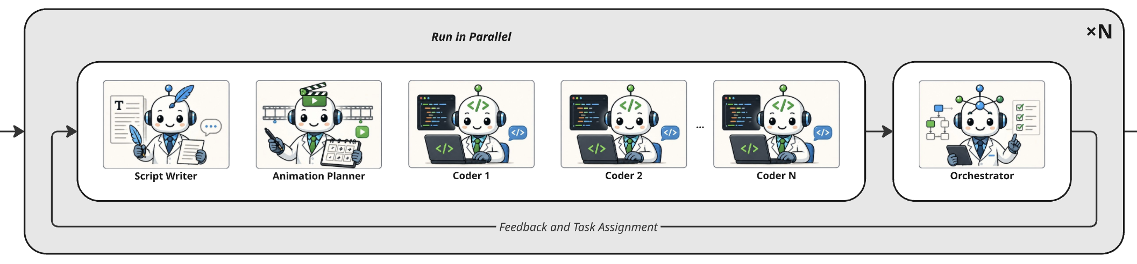
MAS Architecture
Produces structured, role-specific execution traces
Worker-orchestrator architecture, across 3 turns

Slide 7
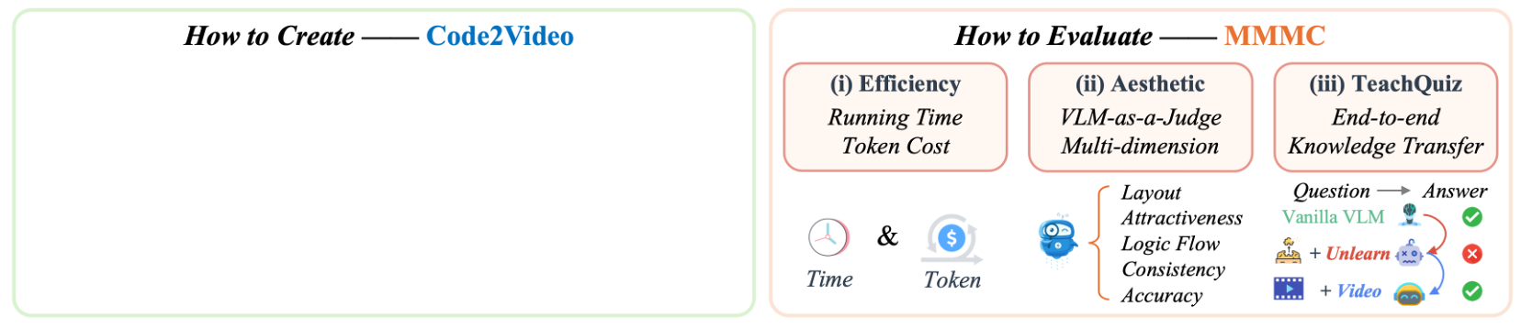
MAS Architecture
Produces structured, role-specific execution traces
Worker-orchestrator architecture, across 3 turns
Adapted from Chen et al. (2025).

Slide 8
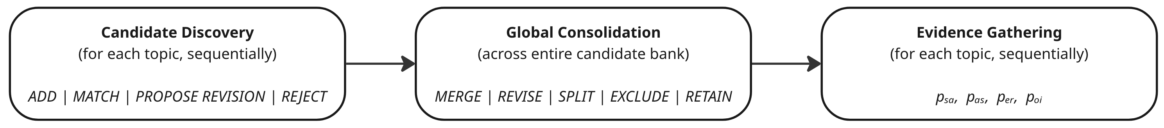
Belief Generation Pipeline
Execution artefacts
BELIEF BASE
Adapted from Chen et al. (2025).

Slide 9
Belief Generation Pipeline
Belief: reusable natural-language instruction derived from evidence
Tool-calling logs, debugging attempts, visual reviews and evaluation results used as inputs
Produced full belief base as output

Slide 10
Belief Generation Pipeline – Stage 1
Sequentially analyses run artefacts from each topic to produce candidate beliefs
Can add, match, revise or reject beliefs (added to log)

Slide 11
Belief Generation Pipeline – Stage 2
Reviews all candidates and supporting observations together
Merges together similar beliefs
Resolves proposed revisions
Can also split, exclude or retain candidates

Slide 12
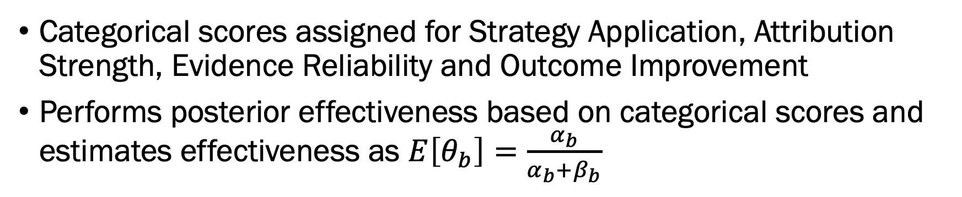
Belief Generation Pipeline – Stage 3
Categorical scores assigned for Strategy Application, Attribution Strength, Evidence Reliability and Outcome Improvement
Performs posterior effectiveness based on categorical scores and estimates effectiveness as $E\left[θ_{b}\right]=\frac{α_{b}}{α_{b}+β_{b}}$

Slide 13
Belief Generation Pipeline
Execution artefacts
BELIEF BASE
Adapted from Chen et al. (2025).

Slide 14
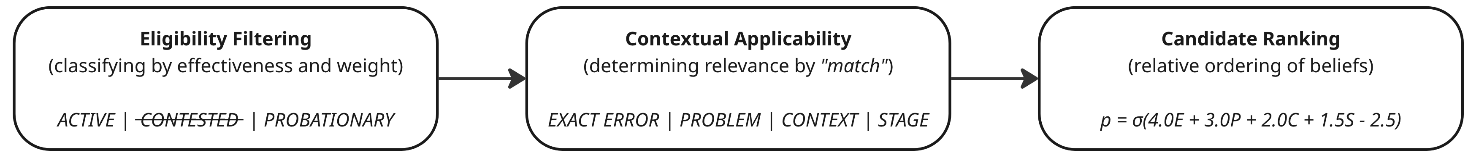
Belief Selection Pipeline
Execution artefacts
Selected Beliefs
BELIEF BASE
Adapted from Chen et al. (2025).

Slide 15
Belief Selection Framework
Aim to select most relevant and applicable beliefs to current situation
Given full belief base as input

Slide 16
Belief Selection Framework – Stage 1
Each belief classified by posterior effectiveness
Filtered out beliefs that were contested and beliefs that weren’t assigned to the current agent

Slide 17
Belief Selection Framework – Stage 2
Scores assigned for matches in Exact Error, Problem, Context and Stage
Semantic similarity involved the use of a BGE-small-en-v1.5 sentence-embedding model

Slide 18
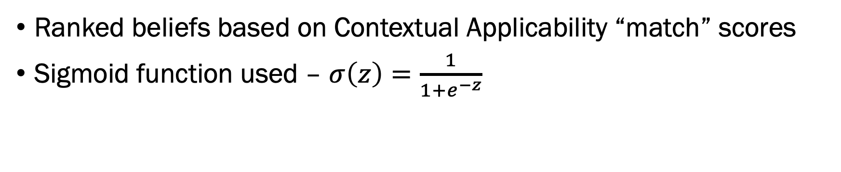
Belief Selection Framework – Stage 3
Ranked beliefs based on Contextual Applicability “match” scores
Sigmoid function used – $σ\left(z\right)=\frac{1}{1+e^{−z}}$

Slide 19
Belief Selection Pipeline
Execution artefacts
Selected Beliefs
BELIEF BASE
Adapted from Chen et al. (2025).

Slide 20
Injection Scopes
“Where should beliefs be injected?”
Broad | Coder-Wide | Reactive Repair
Top 5 beliefs Every agent | Top 5 beliefs Coder agent only | Top (1) belief At runtime failure
Broad
Narrow

Slide 21
Experiment 1: General Improvement
Three 30-topic batches (individually run)
BATCH A
BATCH A
BATCH B
BATCH B
BATCH C
BATCH C
Beliefs
Generation Topics

Slide 22
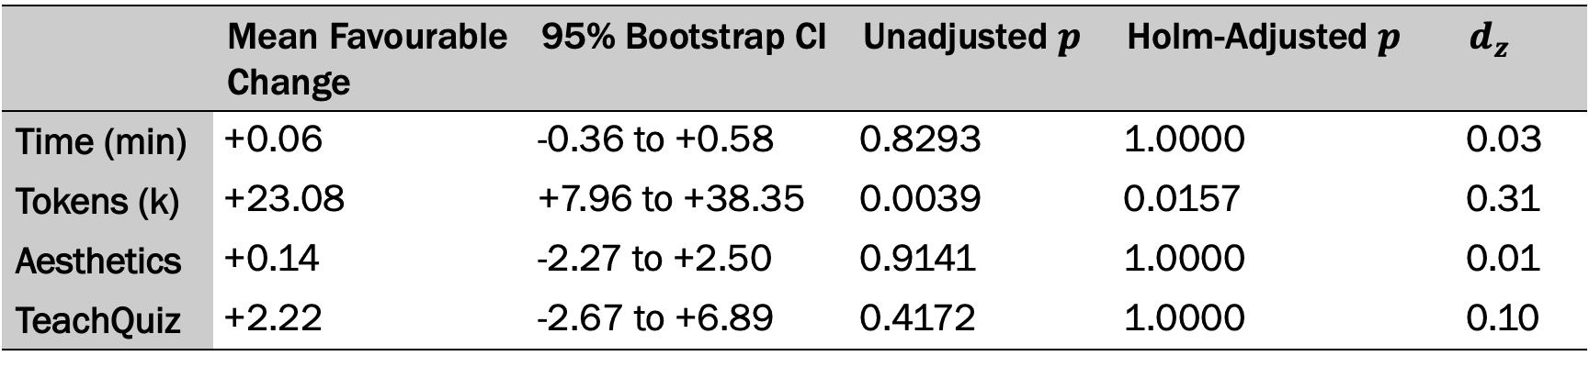
Experiment 1: General Improvement
Three 30-topic batches (individually run)
Calculated improvement for a given topic with and without beliefs
95% CI with 50,000 replacements
 | Mean Favourable Change | 95% Bootstrap CI | Unadjusted $p$ | Holm-Adjusted $p$ | $d_{z}$
Time (min) | +0.06 | -0.36 to +0.58 | 0.8293 | 1.0000 | 0.03
Tokens (k) | +23.08 | +7.96 to +38.35 | 0.0039 | 0.0157 | 0.31
Aesthetics | +0.14 | -2.27 to +2.50 | 0.9141 | 1.0000 | 0.01
TeachQuiz | +2.22 | -2.67 to +6.89 | 0.4172 | 1.0000 | 0.10

Slide 23

Experiment 1: General Improvement
Evidence of statistically significant improvement in token usage
No significant change in other metrics
 | Mean Favourable Change | 95% Bootstrap CI | Unadjusted $p$ | Holm-Adjusted $p$ | $d_{z}$
Time (min) | +0.06 | -0.36 to +0.58 | 0.8293 | 1.0000 | 0.03
Tokens (k) | +23.08 | +7.96 to +38.35 | 0.0039 | 0.0157 | 0.31
Aesthetics | +0.14 | -2.27 to +2.50 | 0.9141 | 1.0000 | 0.01
TeachQuiz | +2.22 | -2.67 to +6.89 | 0.4172 | 1.0000 | 0.10

Slide 24
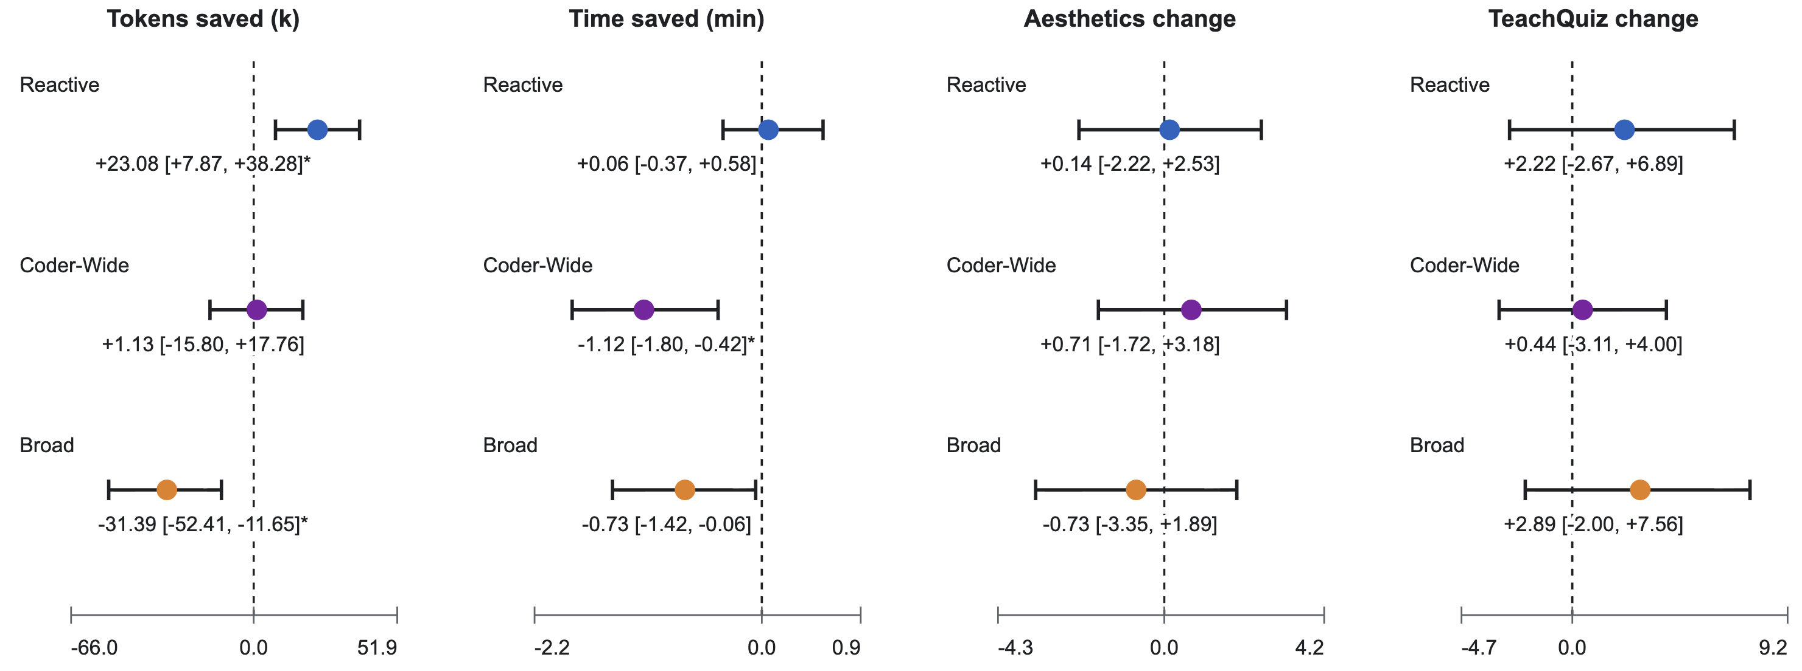
Experiment 2: Injection Scope

Slide 25
Experiment 2: Injection Scope

Slide 26
Experiment 2: Injection Scope

Slide 27
Why Injection Scope Matters
Broad | Reactive Repair
Animation planning begins “Prioritize concrete, high-fidelity mobjects representing physical components.” High-fidelity mobjects added to script: More complex objects/details required Code becomes more complex to accommodate (complexity propagates)

Slide 28
Why Injection Scope Matters
Broad | Reactive Repair
Animation planning begins “Prioritize concrete, high-fidelity mobjects representing physical components.” High-fidelity mobjects added to script: More complex objects/details required Code becomes more complex to accommodate (complexity propagates)

Slide 29
Why Injection Scope Matters
Broad | Reactive Repair
Animation planning begins “Prioritize concrete, high-fidelity mobjects representing physical components.” High-fidelity mobjects added to script: More complex objects/details required Code becomes more complex to accommodate (complexity propagates) | TypeError received in Scene.play() “Use .animate or an explicit Animation object when changing a mobject inside Scene.play” Coder changed: self.play(self.lecture[0].set_color(WHITE)) self.play(self.lecture[0].animate.set_color(WHITE)) TypeError successfully resolved

Slide 30
Why Injection Scope Matters
Broad | Reactive Repair
Animation planning begins “Prioritize concrete, high-fidelity mobjects representing physical components.” High-fidelity mobjects added to script: More complex objects/details required Code becomes more complex to accommodate (complexity propagates) | TypeError received in Scene.play() “Use .animate or an explicit Animation object when changing a mobject inside Scene.play” Coder changed: self.play(self.lecture[0].set_color(WHITE)) self.play(self.lecture[0].animate.set_color(WHITE)) TypeError successfully resolved

Slide 31
Experiment 3: Transferability
Cross-batch and within-batch belief transfer evaluated across all three batches
BATCH A
BATCH A
BATCH B
BATCH B
BATCH C
BATCH C
Beliefs
Generation Topics

Slide 32
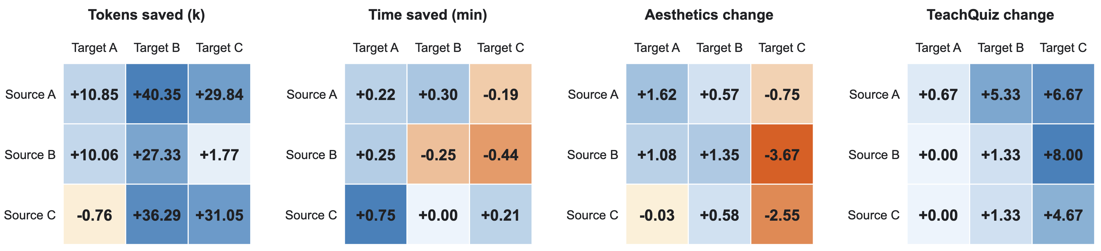
Experiment 3: Transferability
Cross-batch and within-batch belief transfer evaluated across all three batches
Results given compared to no-belief baseline

Slide 33
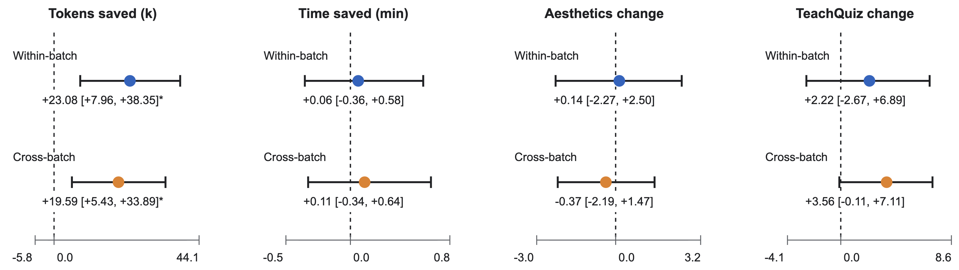
Experiment 3: Transferability
Transferred statistically significant token-efficiency benefit
Other metrics have unclear improvements

Slide 34
Conclusions and Future Work
Execution artefacts
Selected Beliefs
BELIEF BASE
Adapted from Chen et al. (2025).

Slide 35
Conclusions and Future Work
Key Findings:
Beliefs improved generation efficiency (token usage)
Injection scope affects whether beliefs help or hinder (Reactive Repair was the most favourable)
Beliefs transferred to unseen topics (token savings transferred)
What’s Next:
Continuous belief base refinement (building on an existing base)
Learning belief selection coefficients

Slide 36
References
Chen, Y., Lin, K. Q., & Shou, M. Z. (2025). Code2Video: A code-centric paradigm for educational video generation. arXiv. https://arxiv.org/abs/2510.01174
Ho, J., Salimans, T., Gritsenko, A., Chan, W., Norouzi, M., & Fleet, D. (2022). Video diffusion models. Advances in Neural Information Processing Systems, 35. https://proceedings.neurips.cc/paper_files/paper/2022/hash/39235c56aef13fb05a6adc95eb98d66-Abstract-Conference.html

Slide 37
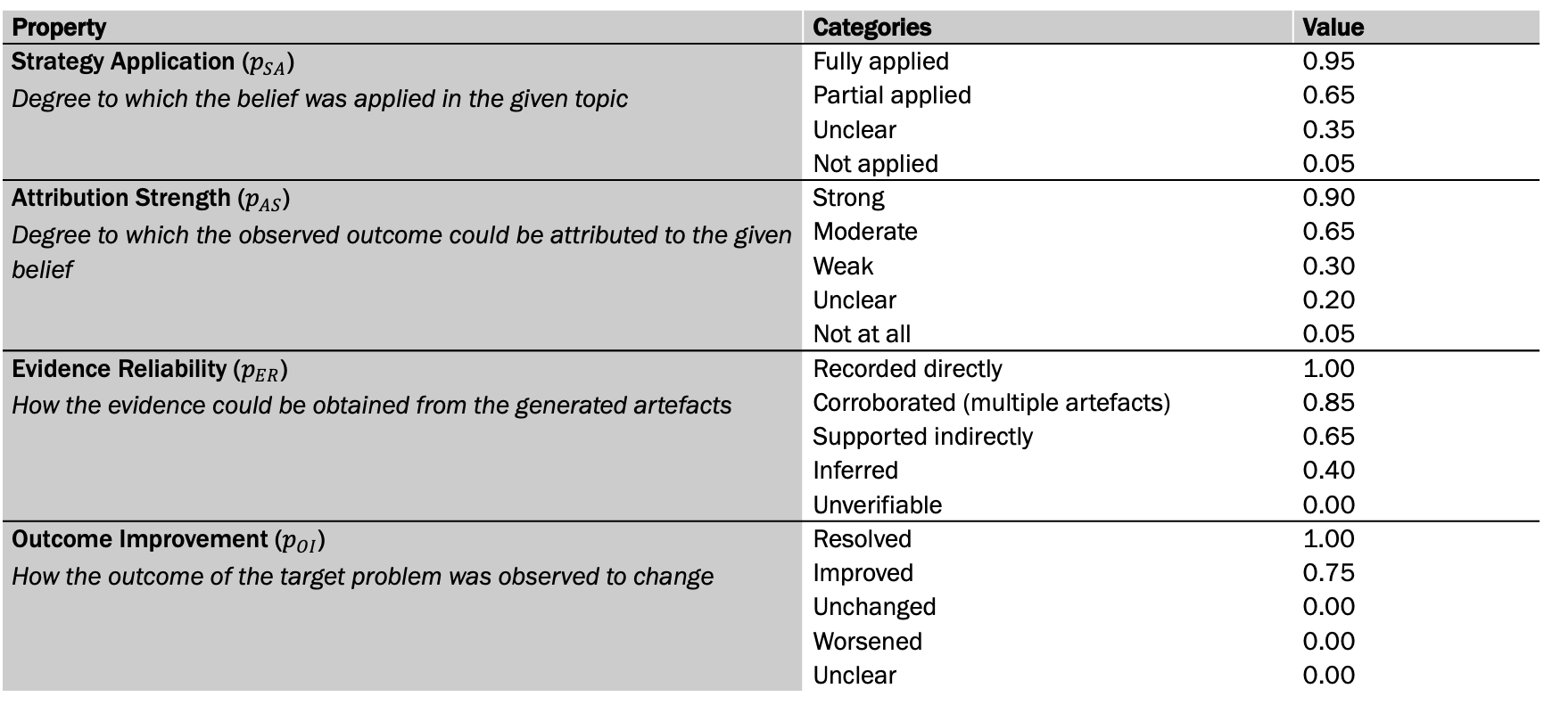
Appendix A: Evidence Gathering Scores
Property | Categories | Value
Strategy Application ($p_{SA}$) Degree to which the belief was applied in the given topic | Fully applied | 0.95
 | Partial applied | 0.65
 | Unclear | 0.35
 | Not applied | 0.05
Attribution Strength ($p_{AS}$) Degree to which the observed outcome could be attributed to the given belief | Strong | 0.90
 | Moderate | 0.65
 | Weak | 0.30
 | Unclear | 0.20
 | Not at all | 0.05
Evidence Reliability ($p_{ER}$) How the evidence could be obtained from the generated artefacts | Recorded directly | 1.00
 | Corroborated (multiple artefacts) | 0.85
 | Supported indirectly | 0.65
 | Inferred | 0.40
 | Unverifiable | 0.00
Outcome Improvement ($p_{OI}$) How the outcome of the target problem was observed to change | Resolved | 1.00
 | Improved | 0.75
 | Unchanged | 0.00
 | Worsened | 0.00
 | Unclear | 0.00

Slide 38
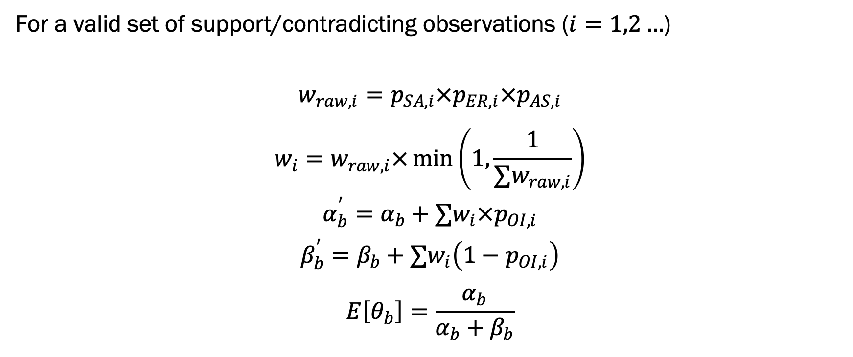
Appendix B: Belief Effectiveness Update
For a valid set of support/contradicting observations ($i=1,2…$)
$$w_{raw,i}=p_{SA,i}×p_{ER,i}×p_{AS,i}$$
$$\begin{aligned}w_{i}=w_{raw,i}×\min\left(1,\frac{1}{∑w_{raw,i}}\right)\end{aligned}$$
$$α_{b}^{′}=α_{b}+∑w_{i}×p_{OI,i}$$
$$β_{b}^{′}=β_{b}+∑w_{i}\left(1−p_{OI,i}\right)$$
$$E\left[θ_{b}\right]=\frac{α_{b}}{α_{b}+β_{b}}$$

Slide 39
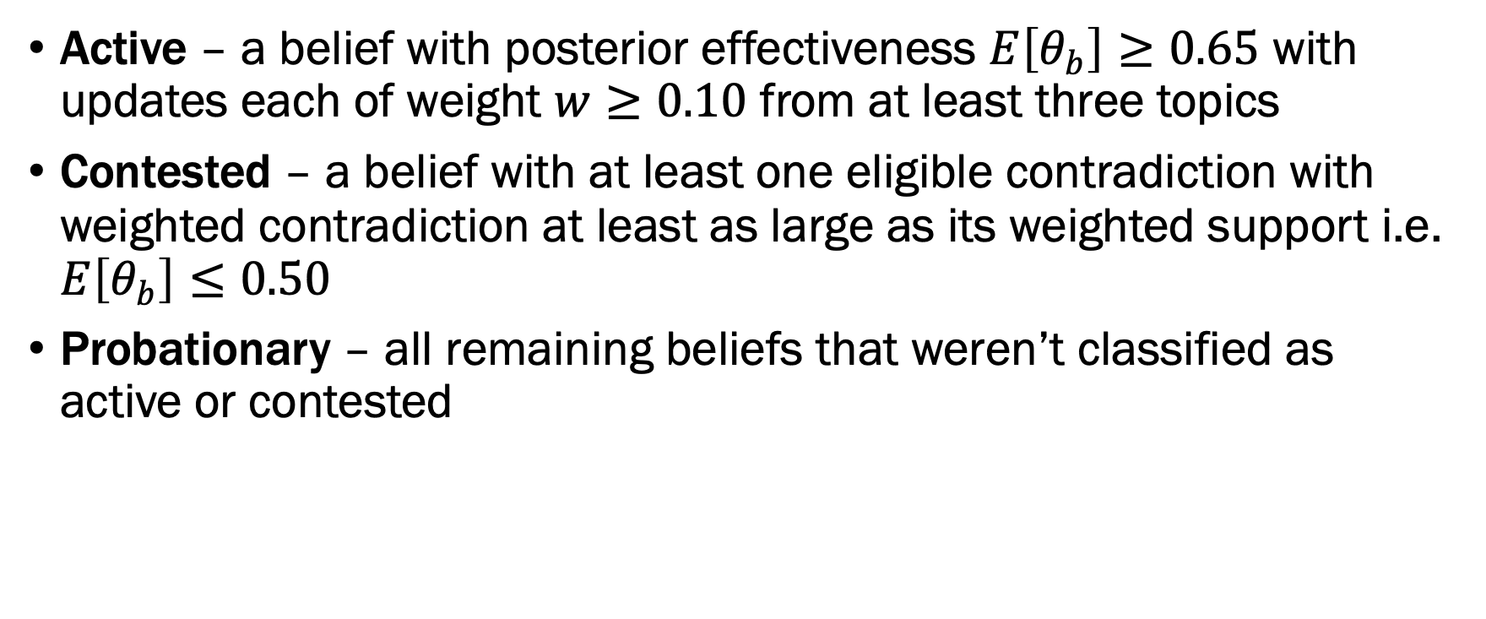
Appendix C: Eligibility Filtering
Active – a belief with posterior effectiveness $E\left[θ_{b}\right]≥0.65$ with updates each of weight $w≥0.10$ from at least three topics
Contested – a belief with at least one eligible contradiction with weighted contradiction at least as large as its weighted support i.e. $E\left[θ_{b}\right]≤0.50$
Probationary – all remaining beliefs that weren’t classified as active or contested

Slide 40
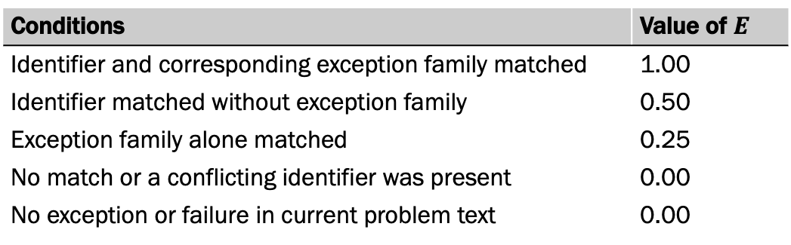
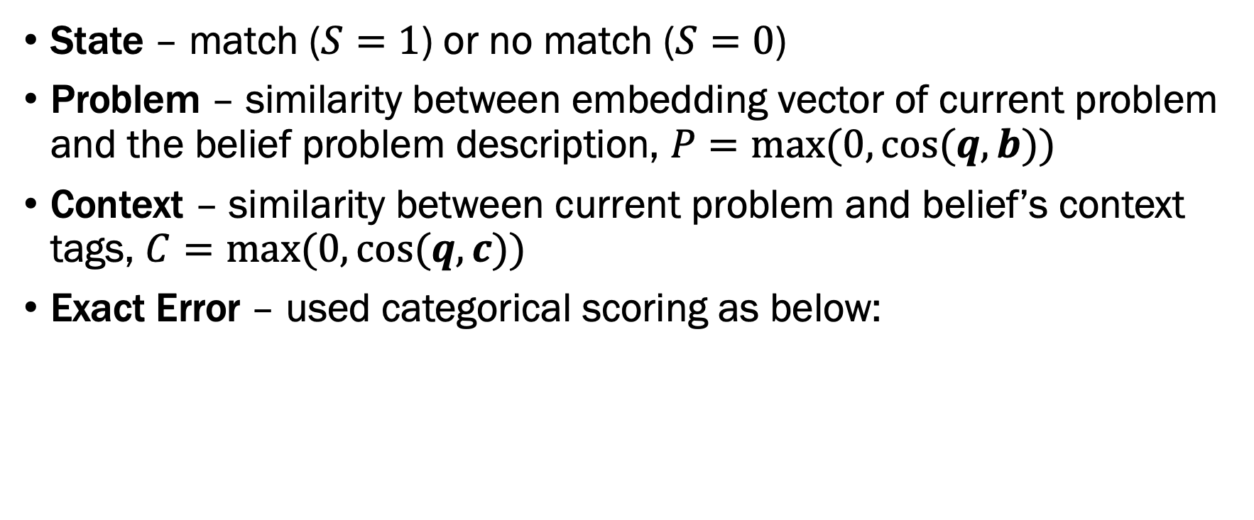
Appendix D: Contextual Applicability Score
State – match ($S=1$) or no match ($S=0$)
Problem – similarity between embedding vector of current problem and the belief problem description, $P=\max{(0,\cos{(q,b))}}$
Context – similarity between current problem and belief’s context tags, $C=\max{(0,\cos{(q,c))}}$
Exact Error – used categorical scoring as below:
Conditions | Value of $E$
Identifier and corresponding exception family matched | 1.00
Identifier matched without exception family | 0.50
Exception family alone matched | 0.25
No match or a conflicting identifier was present | 0.00
No exception or failure in current problem text | 0.00

Slide 41
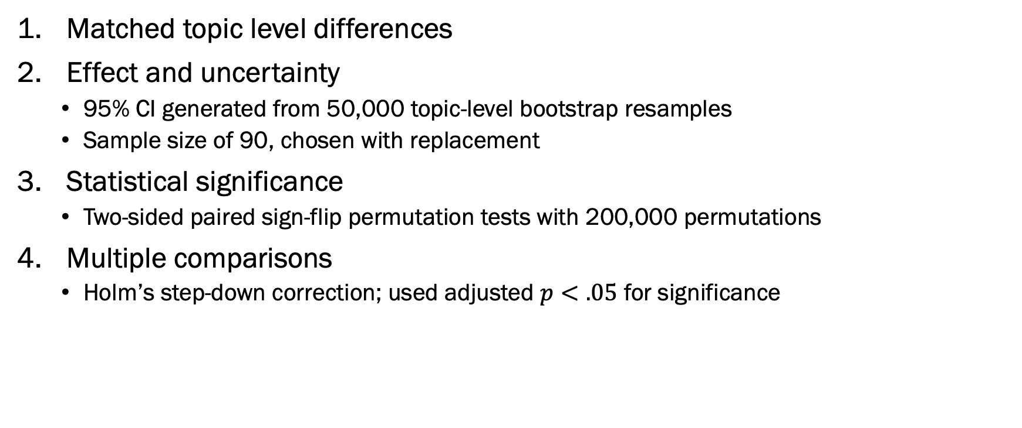
Appendix E: Statistical Method
Matched topic level differences
Effect and uncertainty
  95% CI generated from 50,000 topic-level bootstrap resamples
  Sample size of 90, chosen with replacement
Statistical significance
  Two-sided paired sign-flip permutation tests with 200,000 permutations
Multiple comparisons
  Holm’s step-down correction; used adjusted $p<.05$ for significance

